Slide 1
Agenda
Introductions & What’s New in Azure Databricks
Modern Data Architecture with Azure Databricks & Synapse
Delta Demo & Code Along (Notebooks in https://academy.databricks.com/class/register)
Competitive Plays & Positioning
Break (~15min)
Machine Learning With Azure Databricks
Machine Learning Demo & Code Along (Notebooks in https://academy.databricks.com/class/register)
Hadoop Migrations & Vertical Plays
Wrap Up & Capstone

Slide 2

Competitive Positioning
with Snowflake, EMR and BigQuery

Slide 3


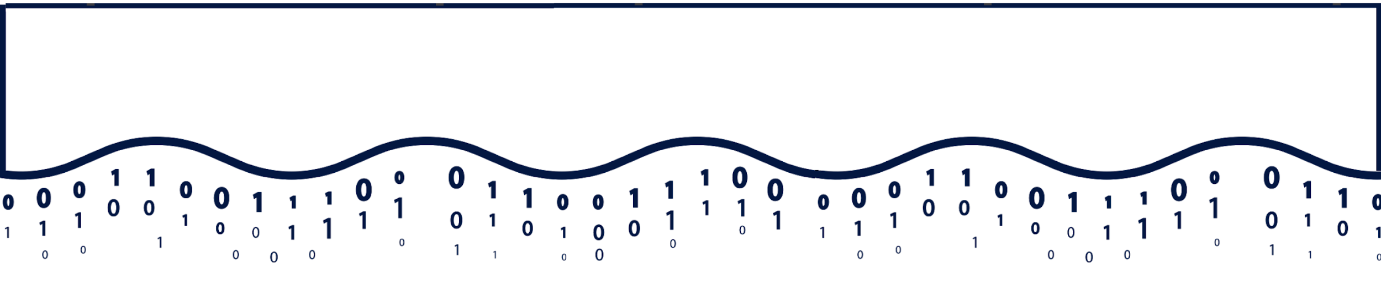







Win With a Modern Data Architecture
Best of Breed Tools
Unified experience for data engineering and science
Powerful serving layer for reporting & BI
Big Data Engineering, Streaming. Data Science and Machine Learning
SQL Analytics, BI, No/Low Code Pipelines
Reporting and dashboards
Cost effective Data Lake
Write-once, access often
De-coupled storage
Lowest cost/TB
ACID pipelines
100x better performance
Curated Data
Raw Data
All data sources
Streaming or batch
Structured
Semi-Structured
Unstructured Data

Slide 4
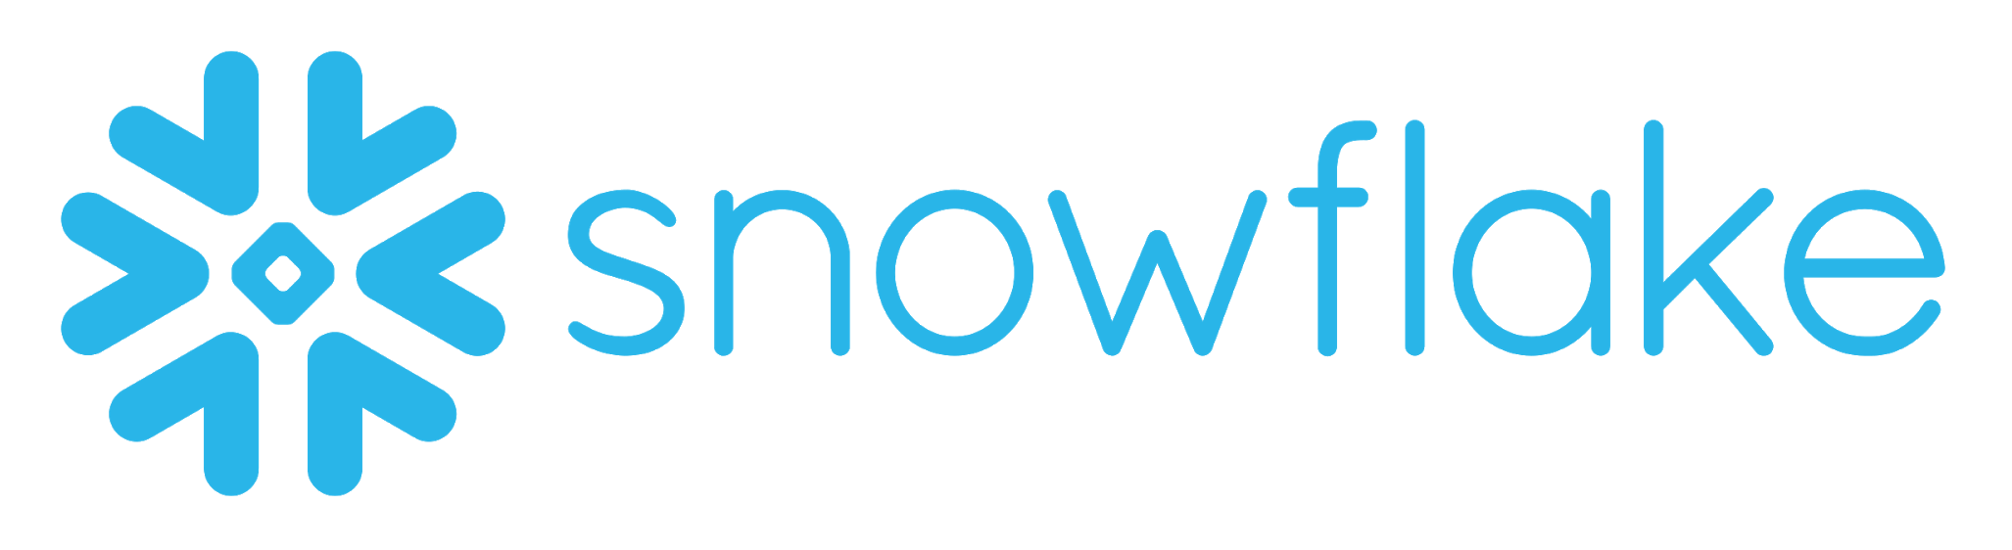
Snowflake: Summary
What is it? | A completely managed Data Warehouse as a Cloud Service available in AWS, Azure, and GCP
Target Workloads | Data warehouse, SQL, BI - moving into data science, ML, streaming and big data use cases
Features | Managed storage (organization, file size, structure, compression, statistics, etc.), virtual data warehouses (shared nothing architecture), time travel (query modified/deleted data), easy batch & continuous data loading with Snowpipe, and data sharing capabilities for internal and external data consumers.
Pricing | Snowflake charges per-second rates inclusive of compute and software ranging from $2-4/credit depending on the pricing tiers (Standard -> Business Critical. Most TPC-DS benchmarks with 1TB use a Large instance (8 credits) which costs ~$32/hour (up to $280k/year). Data storage is billed separately at $40/TB/month on Azure.
Strengths | Easy (completely managed - no complex networking, storage config, data partitioning), perceived unification of data, cloud agnostic, transferrable SQL skills
Weaknesses | SQL only, requires data to be copied in, no data science/ML capabilities, high cost/performance for large data volumes, “Snowflake tax”, can’t handle unstructured data
How We Win | Open, write-once, access often architecture on ADLS, no lock-in, customer owns their data, native & scalable data science/ML on large data sets, true data sharing on ADLS, 100X+ lower cost/performance with Delta

Slide 5
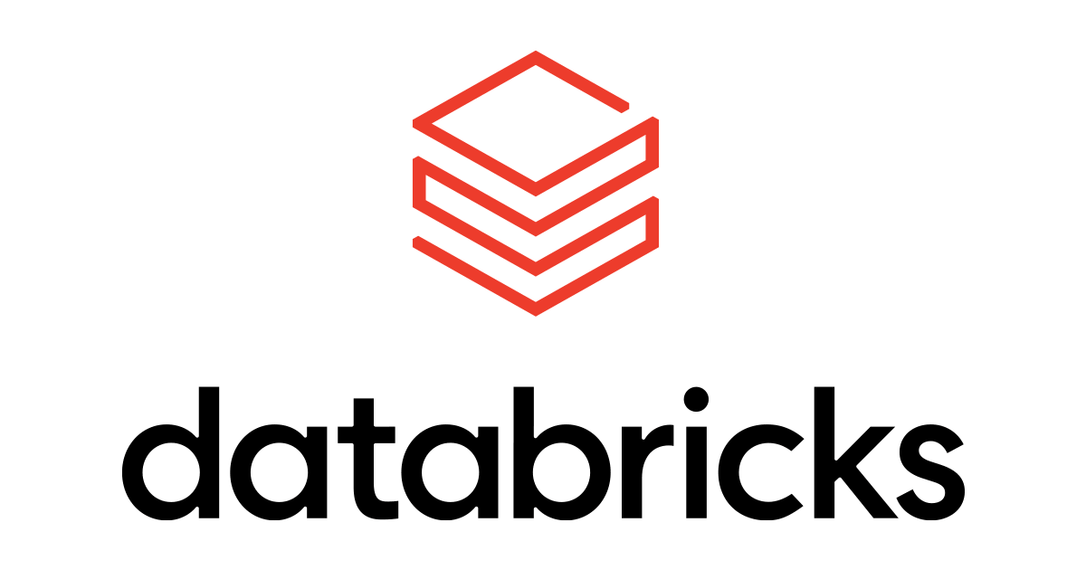
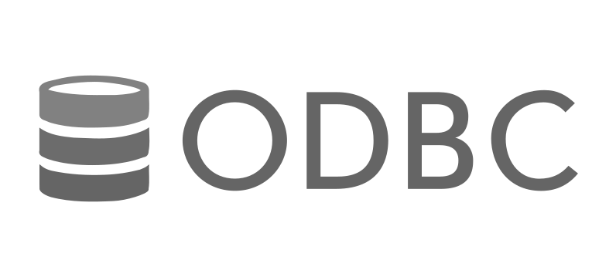
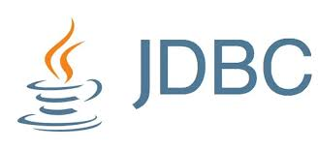







Architectural Limitations of Snowflake Data Platform
MS Internal Only
BI Reports, Dashboards & SQL Analysis
Data Science, Model Training, Scoring & Deployment
Proprietary formats prevent direct data access
Disparate tooling decreases data science productivity
ADLS
Non-SQL Workloads require new data copies
“Snowflake tax” for all data access
Snowflake costs 10-20X more than Databricks for ETL workloads
Your data is copied into Snowflake’s tenant
No support for modern, high value data sources
Snowflake can’t handle unstructured data, resulting in silos
Structured
Semi-Structured
Unstructured Data

Slide 6
The Benefits of a Modern Data Architecture
Unified Tools
SQL, Python, R, Scala, BI
Distributed ML on ADLS
ML Lifecycle Management
Collaborative workspace
Big Data Engineering, Streaming. Data Science and Machine Learning
SQL Analytics, BI, No/Low Code Pipelines
Reporting and dashboards
Curated Data
No data silos
Data stays in your data lake
No data duplication
Open source file formats
Low cost ephemeral ETL
Raw Data
All data sources
Streaming or batch
Structured or unstructured
Structured
Semi-Structured
Unstructured Data

Slide 7
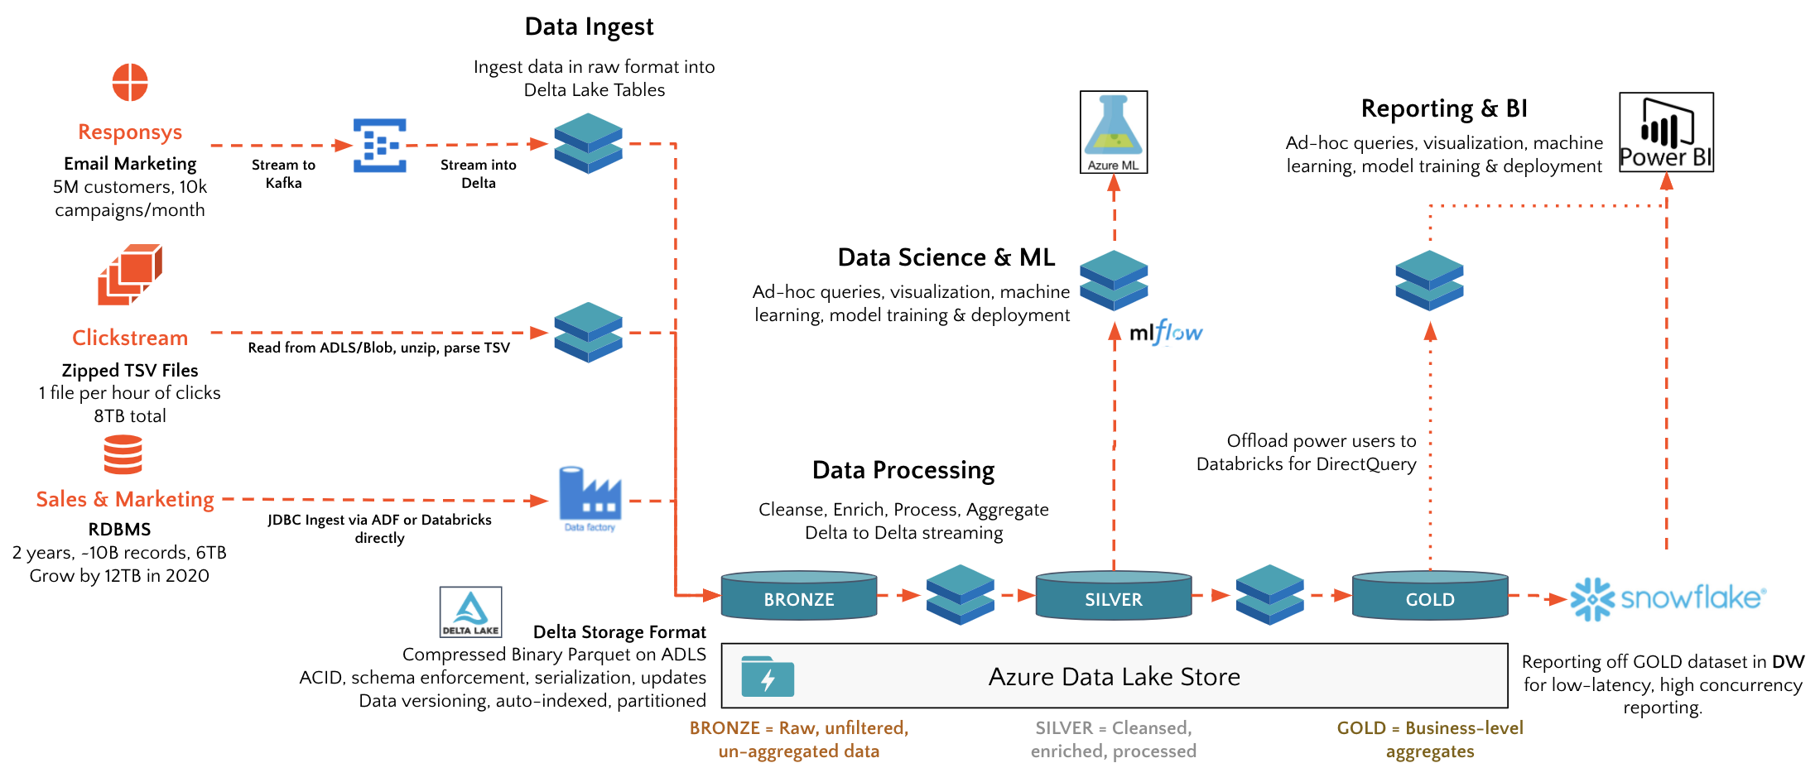
Lululemon - Snowflake Pushout
Architecture
Why Databricks for Data Engineering & ML
5-10X faster queries with ADB on Delta in ADLS Gen 2
100X lower cost for historical data on ADLS vs. Snowflake
All ML & advanced analytics using Spark on Databricks
Unified model tracking (MLflow) and deployment (AzureML)
No data movement required from Snowflake to Databricks
Most data stays in Lululemon’s tenant and Data Lake
How We Won (Microsoft + Databricks)
Use Case Workshop
Identified performance challenges with DW
Sell on Data Lake Arch.
Delta Workshop
How Delta solves data reliability & perf issues
Pick one
Technical Validation
Moved largest dataset to Delta, opened access to data scientists
Success criteria
Weekly Cadence
Support in migrating DW pipelines to Delta

Slide 8

BigQuery: Summary
What is it? | Serverless, managed and now multi-cloud managed data warehouse service
Target Workloads | Data warehousing, BI, data science/ML - does not target ETL workloads (-> DataFlow)
Features | Omni (preview) for querying across clouds, BigQuery ML for training and deploying ML models, BI Engine for in-memory BI, Sheets for non-SQL analysis on tables in BigQuery, NLP Analytics, real-time visualization,
Pricing | BigQuery charges for data storage ($0.02/GB), streaming inserts ($0.05/GB), and querying data on a per query cost basis depending on the amount of data processed ($5/TB).
Strengths | Query on-demand pricing, serverless, cross-cloud queries, built-in ML capabilities, performance
Weaknesses | Long-running queries on large TB-scale datasets can incur significant costs ($100K+), not cost-effective for data engineering workloads, requires data duplication into BigQuery, ML capabilities are very basic (simple models).
How We Win | Open, write-once, access often architecture on ADLS, predictable cost/performance with Delta, lower latency BI on Synapse, stream processing for immediate querying in Delta

Slide 9
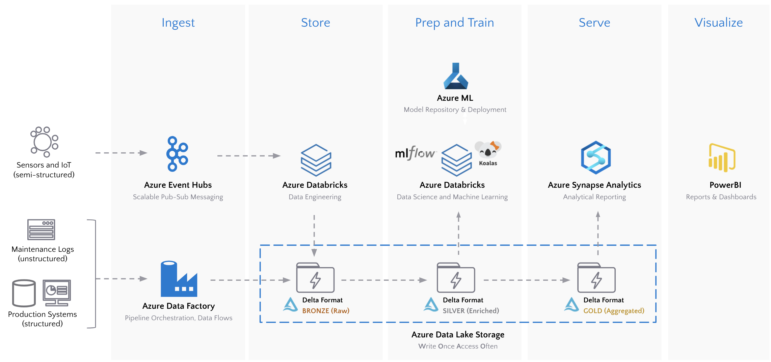
Canadian mining company - GCP BigQuery Competitive Win
Architecture
Why Databricks
1000x lower cost/performance than BigQuery
$100,000 10hr query run in BigQuery vs. $100 2hr query in Delta
Data science pipelines run 10x+ faster, with no code changes
Koalas allows Pandas code to run as-is on Databricks Spark
No data duplication - 2X lower storage costs as all data served in ADLS
Databricks, Synapse, AzureML all natively run on ADLS
GCP requires data to be replicated into BigQuery for SQL queries
Faster ingest pipelines - 3s from data capture to data querying
Delta enables support for streaming MERGE in ADLS
BigQuery requires batch load pipelines, 5-10 min delay in data being available for data scientists and analysts

Slide 10

AWS EMR: Summary
What is it? | AWS’s managed Hadoop offering including an optimized Spark offering
Target Workloads | ETL, Streaming, SQL on Big Data, Data Science/ML
Features | Many open source projects (Hadoop, Presto, Jupyter, Hudi etc.) packaged and rolled into a single click deployment which integrates well with AWS ecosystem. EMR also offers EMR Runtime which has performance enhancements over Open Source Spark, and a data science environment powered by Apache Zeppelin. Apache Hudi is EMR’s storage framework providing transactional guarantees on cloud storage, file size management, and update + delete capabilities.
Pricing | You pay a per-second rate for every second you use, with a one-minute minimum. For example, a 10-node cluster running for 10 hours costs the same as a 100-node cluster running for 1 hour. The hourly rate depends on the instance type used (e.g. standard, high cpu, high memory, high storage, etc), and billing is calculated down to the second and shows time in decimal form. Hourly prices range from $0.011/hour to $0.27/hour ($94/year to $2367/year) per node.
Strengths | Elastic, low perceived cost, flexible, open source. Instance Fleets: AWS EMR can use Spot Instances to guarantee capacity, resulting in up to 90% discount.
Weaknesses | Difficult-to-use, lacks collaboration features, not Data Science friendly (poor integration with SageMaker), risky
How We Win | 10x+ faster performance and simplified pipelines with Delta, more collaborative data science, native integration with AzureML for model deployment, integrated BI experience

Slide 11

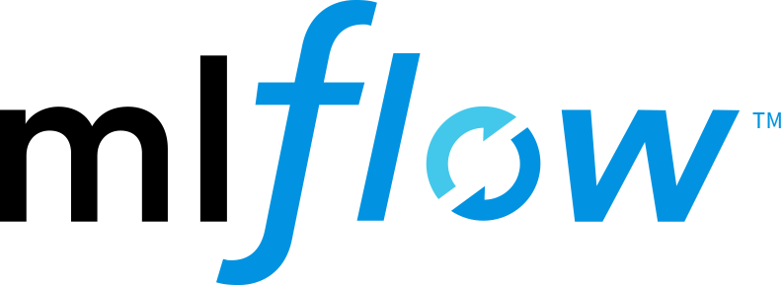
AWS EMR: Competitive Differentiators
Databricks Premium Spark vs. EMR Spark
5,000 customers, 2XB/month processed by the largest of enterprises
Extreme scale running millions of server hours per day
Backed by the original creators and world’s foremost experts
Delta vs. Hudi
Up to 3x (read) to 5x (write) performance gain, simplified architecture
Reliability with ACID transactions, write concurrency and time travel
Schema enforcement, time travel, schema evolution
Databricks Workspace vs. Zeppelin
Enterprise workspace with full access controls and automated versioning
Collaborate with notebook co-authoring and commenting
Built-in visualizations for exploration, ML lifecycle management

Slide 12
AWS EMR: Why we win
Financial Software Company
Global Media Company
Travel Metasearch Engine
Online Real Estate Database
76% reduction in runtime vs. EMR
90% reduction in compute costs, 2x faster
50% reduction in TCO
25% reduction in TCO, 40-90% faster

Slide 13
Win With a Modern Data Architecture
Best of Breed Tools
Unified experience for data engineering and science
Powerful serving layer for reporting & BI
Big Data Engineering, Streaming. Data Science and Machine Learning
SQL Analytics, BI, No/Low Code Pipelines
Reporting and dashboards
Cost effective Data Lake
Write-once, access often
De-coupled storage
Lowest cost/TB
ACID pipelines
100x better performance
Curated Data
Raw Data
All data sources
Streaming or batch
Structured
Semi-Structured
Unstructured Data

Slide 14
Agenda
Introductions & What’s New in Azure Databricks
Modern Data Architecture with Azure Databricks & Synapse
Delta Demo & Code Along (Notebooks in https://academy.databricks.com/class/register)
Competitive Plays & Positioning
Break (~15min)
Machine Learning With Azure Databricks
Machine Learning Demo & Code Along (Notebooks in https://academy.databricks.com/class/register)
Hadoop Migrations & Vertical Plays
Wrap Up & Capstone

